Slide 1
Credit Risk Modeling- American Express

Slide 2
Executive Summary
American Express revenue 2022 - $53 Billion
Impact of Credit Risk Modelling
Role of Data Science and AI
 | Train |  |  | Test 1 |  |  | Test 2 |  |  | Overall
Strategy | #Total | Default Rate | Revenue | #Total_1 | Default Rate_1 | Revenue_1 | #Total_2 | Default Rate_2 | Revenue_2 | #Total_ | Default Rate_ | Revenue_
Conservative (50%) | 228,384 | 6.89% | 2,724.78 | 47,995 | 8.69% | 564.42 | 63,954 | 8.49% | 742.00 | 349,608 | 8.64% | 4,061.55
Aggressive (30%) | 204,573 | 3.34% | 2,614.34 | 43,201 | 5.03% | 542.97 | 56,268 | 4.25% | 705.16 | 322,203 | 5.39% | 3,957.77

Slide 3
Data
Month | Observations | Default Rate
03/17 | 30,730 | 23.34%
04/17 | 31,233 | 23.53%
05/17 | 31,048 | 23.76%
06/17 | 31,815 | 24.79%
07/17 | 32,620 | 24.71%
08/17 | 33,253 | 25.64%
09/17 | 33,427 | 26.13%
10/17 | 34,439 | 26.44%
11/17 | 35,664 | 26.35%
12/17 | 36,977 | 26.88%
01/18 | 38,957 | 27.17%
02/18 | 41,614 | 27.93%
03/18 | 47,136 | 27.74%
Historical Credit Card (CC) data consists of 458,913 customers spread across 13 months on 190 variables in categories like Payment, Spend and Balance
30k – 40k observation each month and % of customers defaulted in each month [23%, 28%]
Target Variable = 1 if customer default on CC payment
= 0 if customer didn’t default

Slide 4
Features
Category | # of Features
Delinquency | 96
Spend | 22
Payment | 3
Balance | 40
Risk | 29
All Features divided into 5 categories:
Delinquency, Payment, Balance, Risk & Spend
Summary of Top 5 features with highest SHAP value on final XGBoost model
Features | count | mean | std | min | 1% | 5% | 50% | 95% | 99% | max | %Missing
P_2 | 2,68,249 | 0.6539 | 0.2407 | -0.3842 | 0.0285 | 0.2337 | 0.6860 | 0.9746 | 1.0057 | 1.0100 | 0.0037
B_17 | 1,47,759 | 0.6812 | 0.4151 | 0.0000 | 0.0005 | 0.0022 | 0.9394 | 1.0086 | 1.0097 | 1.0100 | 0.4512
D_53 | 87,144 | 0.0736 | 0.1895 | 0.0000 | 0.0003 | 0.0014 | 0.0141 | 0.3417 | 0.9238 | 6.1719 | 0.6763
S_3 | 2,36,579 | 0.2292 | 0.1920 | -0.5421 | 0.0092 | 0.0656 | 0.1669 | 0.6055 | 1.0078 | 4.8824 | 0.1213
B_4 | 2,69,243 | 0.1683 | 0.2170 | 0.0000 | 0.0007 | 0.0036 | 0.0809 | 0.6085 | 0.9808 | 3.5920 | 0.0000

Slide 5
Sampling
Data | Time Period | Observations | Default Rate
Train | 2017/05-2018/01 | 308,200 | 25.83%
Test1 | 2017/03-2017/04 | 61,963 | 23.43%
Test2 | 2018/02-2018/03 | 88,750 | 27.83%
Test1 and Test2 before and after the training period to maintain randomness of unseen data and not create bias due to time period
Default Rate increases with Time

Slide 6
Data Processing – One Hot Encoding
Categorical Variables - D_63 & D_64 ( Unique Values – 6 & 4 respectively)
D_63 – ['CR', 'CO', 'CL', 'XZ', 'XM', 'XL’] & D_64 - ['O', 'R', 'U', '-1', None]
df_new1 = pd.get_dummies(df1, columns = ['D_63', 'D_64'], drop_first = True)
In one-hot encoding 1 variable is always base case
customer_ID | S_2 | P_2 | D_39 | B_1 | target | D_63_CO | D_63_CR | D_63_XL | D_63_XM | D_63_XZ | D_64_O | D_64_R | D_64_U
1 | 16/07/17 | 0.9472 | 0.0025 | 0.0152 | 0 | 0 | 1 | 0 | 0 | 0 | 1 | 0 | 0
2 | 06/02/18 | 0.8789 | 0.5363 | 0.0346 | 0 | 1 | 0 | 0 | 0 | 0 | 1 | 0 | 0
3 | 11/11/17 | 0.7977 | 0.0028 | 0.0032 | 0 | 1 | 0 | 0 | 0 | 0 | 0 | 1 | 0
4 | 03/02/18 | 0.6234 | 0.0084 | 0.0146 | 0 | 1 | 0 | 0 | 0 | 0 | 1 | 0 | 0
5 | 30/01/18 | 0.8813 | 0.0007 | 0.0098 | 0 | 1 | 0 | 0 | 0 | 0 | 1 | 0 | 0

Slide 7
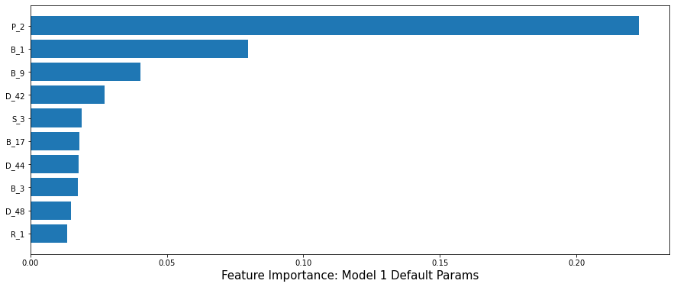
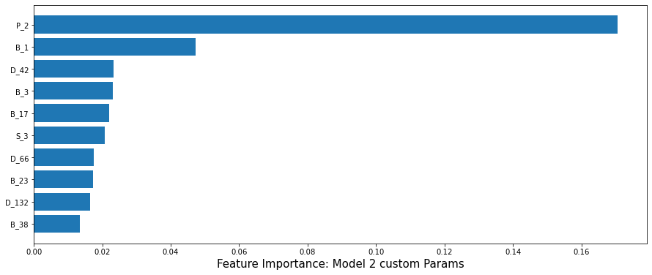

Feature Selection
Features with Feat_Imp > 0.005 in atleast one of the models
Model 1 (Imp feats) = 38 & Model 2 = 35
Category | # of Features | # Selected
Delinquency | 103 | 27
Spend | 22 | 3
Payment | 3 | 2
Balance | 40 | 11
Risk | 29 | 3

Slide 8
XGBoost - Grid Search
t1 = t.time()
grid_search = pd.DataFrame(columns = ['No. of Trees', 'LR', 'Subsample', '%features', 'Default Weight', 'AUC Train', 'AUC Test1', 'AUC Test2'])
num_trees = [50, 100, 300]
lr = [0.01, .1]
subsample = [.5, .8]
feat = [.5, 1]
def_w = [1, 5, 10]
row = 0
for i in num_trees:
for j in lr:
for k in subsample:
for f in feat:
for d in def_w:
xgb_inst = xgb.XGBClassifier(n_estimators = i, learning_rate = j, subsample = k, colsample_bytree = f, scale_pos_weight = d, random_state = 21)
model = xgb_inst.fit(xtrain, ytrain)
grid_search.loc[row, 'No. of Trees'] = i
grid_search.loc[row, 'LR'] = j
grid_search.loc[row, 'Subsample'] = k
grid_search.loc[row, '%features'] = f
grid_search.loc[row, 'Default Weight'] = d
grid_search.loc[row,"AUC Train"] = roc_auc_score(ytrain, model.predict_proba(xtrain)[:,1])
grid_search.loc[row,"AUC Test1"] = roc_auc_score(ytest1, model.predict_proba(xtest1)[:,1])
grid_search.loc[row,"AUC Test2"] = roc_auc_score(ytest2, model.predict_proba(xtest2)[:,1])
row += 1
t2 = t.time()
print(t2-t1)
The following combinations in the grid search:
Number of trees: 50, 100, and 300 : 50 to decrease the complexity and the variance, then we tried 300 for lower bias
Learning Rate: 0.01, 0.1 : 0.1 – Conventional and 0.01 to validate if slower learning rate arrive at global minima smoothly without overshooting
Percentage of observations used in each tree: 50%, 80% - 50% for faster training & 80% to avoid overfitting
Percentage of features used in each tree: 50%, 100% - 50% again to avoid overfitting and faster training and 100% for better results and low bias
Weight of default observations: 1, 5, 10 – Since most of are non-default we need weights > 1
Above Combination of hyper-parameters yields 72 models
From the AUC of Train, Test1 and Test2, we conclude that there isn’t intrinsic difference between those splits as the variance is low across all models
Chose model with lowest bias : Best Params

Slide 9
XGBoost - Grid Search
Plot 1 : Technically, Bias-Variance Tradeoff at X=0.94 & Y = 0.0075 (diff in Y is small, therefore lowest bias preferred)
Plot 2: Linear relationship between AUC train and test2, therefore highest AUC train preferred

Slide 10
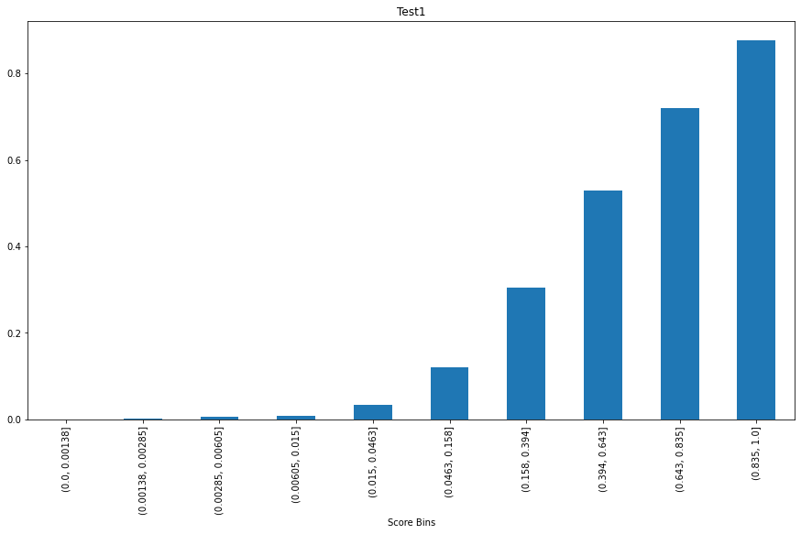
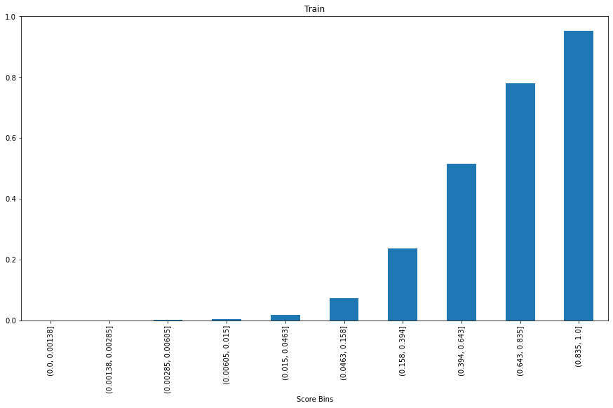
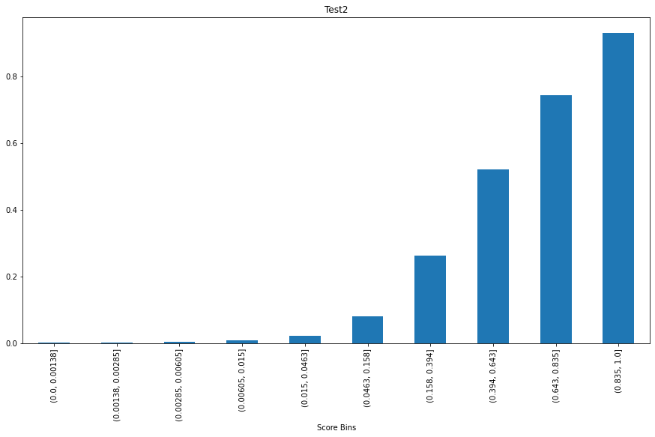
XGBoost – Final Model
No. of Trees | LR | Subsample | %features | Default Weight | AUC Train | AUC Test1 | AUC Test2
300 | 0.1 | 0.8 | 1 | 1 | 95.704% | 93.134% | 94.240%

Slide 11
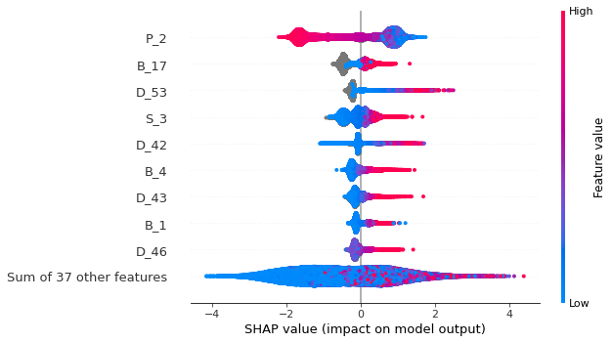
XGBoost – SHAP Analysis (BeeSwarm)
Explains cumulative impact of features on model
Features descending order of importance
P_2 higher values drive the score down meaning higher the payment variable lower will be probability of default
Most features increase their impact on model output with higher feature value

Slide 12
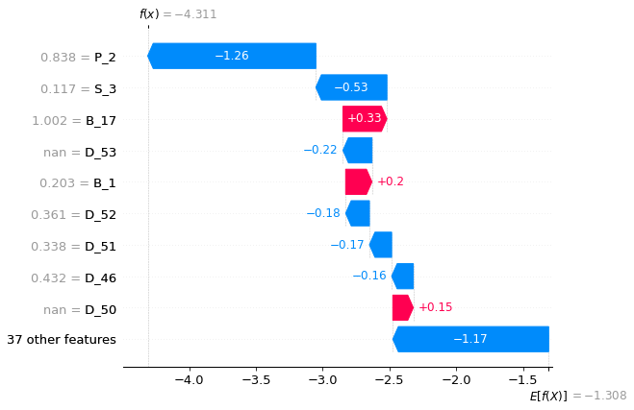
XGBoost – SHAP Analysis (Waterfall)
Explains prediction for specific observation
Expected Model Output = -1.308
Output for 1100th customer = -4.311
P_2 singlehandedly drives prediction down by 1.26 whereas 37 other features collectively drive it down by 1.17

Slide 13
Neural Network – Data Processing
Outlier Detection Removed values < 1 percentile and > 99 percentile
Normalisation Calculated mean and Std Dev for xtrain and transformed xtrain, xtest1 and xtest2
Missing Imputation Replaced Null values with 0

Slide 14

Neural Network - Grid Search
Combination of Hyper-Parameters in the grid search:
Number of hidden layers: 2, 4 – 4 to increase the complexity to get low bias and 2 for faster runtime
# nodes in each hidden layer: 4, 6 – 2 for simple neural network and 6 for complex neural network
Activation function: ReLu, Tanh – ReLu isn’t saturated/zero-centered, tanh causes vanishing gradients
Dropout regularization: 50%, 100% (no dropout) – 50% to decrease complexity and avoid overfitting
Batch size: 100, 10000 – 100 not low enough to overfit every batch and 10000 for faster processing
Combination of hyper-parameters made us train 32 models
From the AUC of Train, Test1 and Test2, we conclude that there isn’t intrinsic difference between those splits as the variance is low across all models
Chose model with lowest bias : Best Params (next slide)
Code :

Slide 15
Neural Network - Grid Search
Plot 1 : Technically, Bias-Variance Tradeoff achieved at X=0.935 & Y = 0.0075 (diff in Y is small, therefore lowest bias preferred)
Plot 2: Linear relationship between AUC train and test2, therefore highest AUC train (lowest bias) preferred

Slide 16
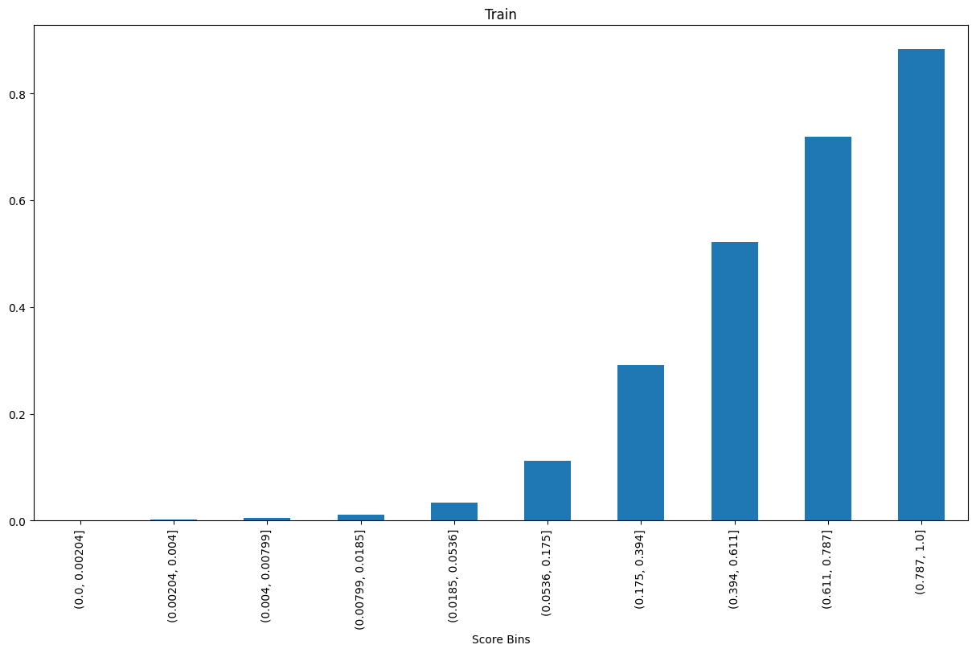
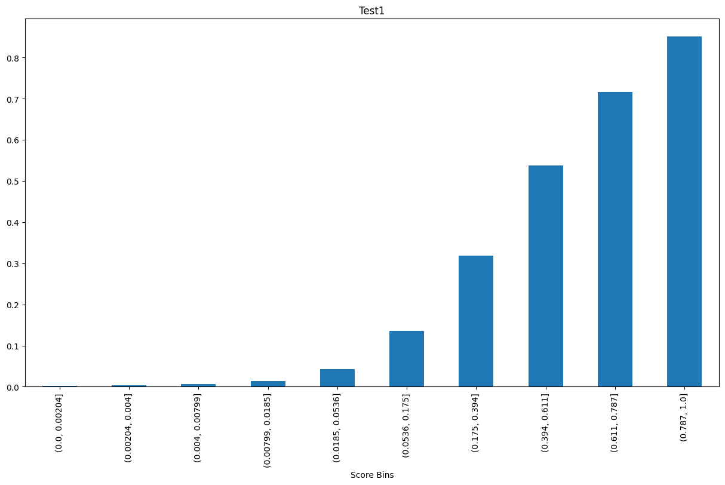
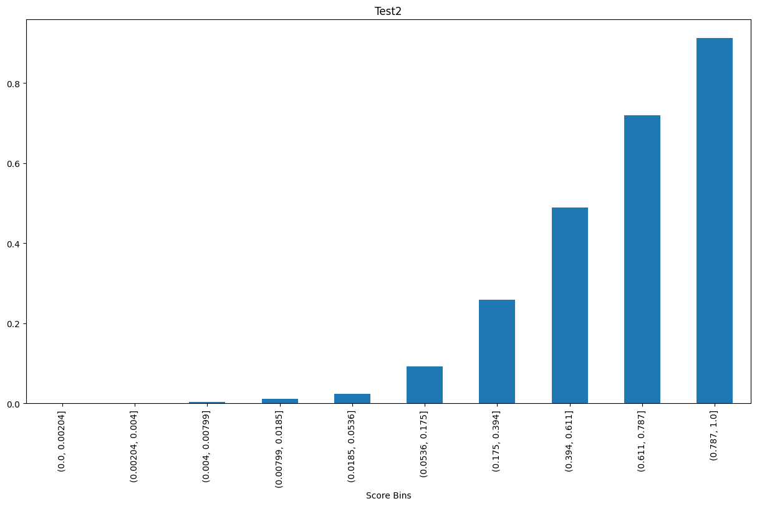
Neural Network – Final Model
hd | nodes | activation | dropout | batch_size | auc_train | auc_test1 | auc_test2 | Avg | Std Dev
2 | 6 | relu | 0 | 100 | 93.409% | 92.496% | 94.091% | 93.332% | 0.008

Slide 17
Final Model
Bias – Winner XGBoost
Variance – Winner Neural Network (diff in Std Dev is negligible)
Explanability – Winner XGBoost ( SHAP Analysis)
Model | AUC Train | AUC Test1 | AUC Test 2 | Avg | Std Dev
XGBoost | 95.704% | 93.134% | 94.240% | 94.360% | 0.01289
Neural Network | 93.409% | 92.496% | 94.091% | 93.332% | 0.00800

Slide 18
Strategy
 | Train |  |  | Test 1 |  |  | Test 2 |  |  | Overall
Threshold | #Total | Default Rate | Revenue | #Total_1 | Default Rate_1 | Revenue_1 | #Total_2 | Default Rate_2 | Revenue_2 | #Total_ | Default Rate_ | Revenue_
0.1 | 172,995 | 1.00% | 2,371 | 36,684 | 1.94% | 496 | 46,549 | 1.30% | 629 | 256,228 | 1.19% | 3,496
0.2 | 191,455 | 2.09% | 2,528 | 40,481 | 3.41% | 527 | 52,125 | 2.65% | 677 | 284,061 | 2.38% | 3,732
0.3 | 204,573 | 3.34% | 2,614 | 43,201 | 5.03% | 543 | 56,268 | 4.25% | 705 | 304,042 | 3.75% | 3,862
0.4 | 216,506 | 4.89% | 2,677 | 45,593 | 6.77% | 555 | 60,104 | 6.14% | 726 | 322,203 | 5.39% | 3,958
0.5 | 228,384 | 6.89% | 2,725 | 47,995 | 8.69% | 564 | 63,954 | 8.49% | 742 | 340,333 | 7.44% | 4,031
0.6 | 240,891 | 9.38% | 2,764 | 50,440 | 11.06% | 571 | 68,082 | 11.36% | 755 | 359,413 | 9.99% | 4,090
0.7 | 254,848 | 12.53% | 2,791 | 53,052 | 13.67% | 577 | 72,316 | 14.45% | 764 | 380,216 | 13.05% | 4,132
0.8 | 271,002 | 16.49% | 2,809 | 56,007 | 16.78% | 582 | 77,042 | 18.17% | 771 | 404,051 | 16.85% | 4,162
0.9 | 290,154 | 21.34% | 2,818 | 59,264 | 20.38% | 586 | 82,638 | 22.78% | 775 | 432,056 | 21.48% | 4,179
1 | 308,200 | 25.83% | 2,820 | 61,963 | 23.43% | 587 | 88,750 | 27.83% | 776 | 458,913 | 25.89% | 4,182
def strategy(x, actual, pred, threshold, balance = 'B_2', spend = 'S_3'): ydf = pd.DataFrame({'actual': actual, 'pred': pred}) df = pd.concat([x, ydf], axis = 1) #Concat X, Actual & Prediction total = df.loc[df['pred'] < threshold].shape[0] #Count observation less than threshold default = df.loc[df['pred'] < threshold, 'actual'].mean() # Default rate df['revenue'] = df.apply(lambda x: x[balance]*0.02 + x[spend]*.001 if x['actual'] != 1 else 0, axis = 1) #Calculate revenue revenue = df.loc[df['pred'] < threshold, 'revenue'].sum() return [total, default, revenue] def ex_sum(xdf, actual, pred, balance = 'B_2', spend = 'S_3'): summary = pd.DataFrame(columns = ['Threshold', '#Total', 'Default Rate', 'Revenue']) summary['Threshold'] = [(i+1)*0.1 for i in range(10)] for i in range(10): summary.iloc[i, 1:] = strategy(xdf, actual, pred, summary.iloc[i, 0] , balance = 'B_2', spend = 'S_3') return summary
Notes:
0.5 – Conservative strategy because we want to increase our Revenue while maintaining the default rate below 10%
0.3 – Aggressive Strategy because the default decreases almost by half but revenue isn’t drastically affected

